Slide 1
First fits of arts lookuptable
1 dimensional linear fits of O3/CO2 athmosphere
Group meeting
26.06.24
Notes:
O2 and CO2 neglect second order effects like dependance of density and homogenously distributed

Slide 2
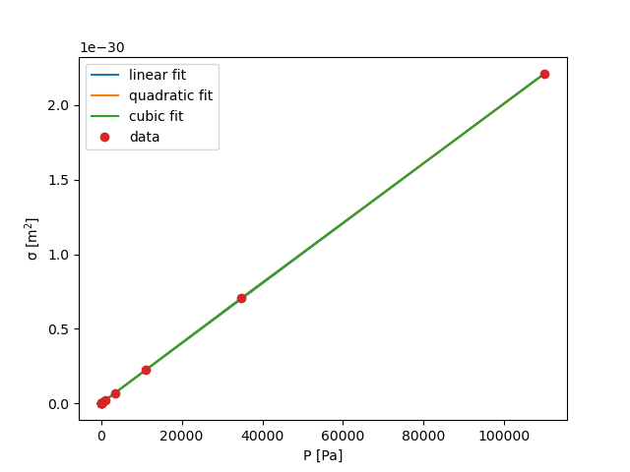
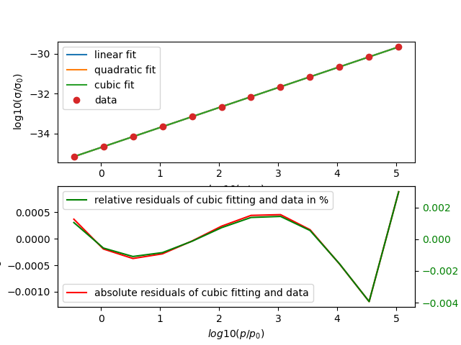
CO₂ far away from absorption peak
Frequency : 1003 cm⁻¹
Temperature: 240 K
Fitted abs. cross section
already linear fit sufficient
Frequency : 1003 cm⁻¹
Temperature: 240 K
Fitted log10(abs. cross section)
already linear fit sufficient
(res = 1.35 * 10^(-5))
(rmse = 0.00053 for 240 K
and rmse = 0.0023 for 360 K)
[%]
Notes:
Change axis description of non-log plot and zoom into
Can we explain the linear log(p) dependancy of the absorption sigma with the thermal occupation part and a low degree of degeneracy in the formula 9.16 (p.165) from the book Molekuelphysik und Quantenchemie
But this formula doesn”t contain the pressure dependance so far (important for width of absorption peak (maybe in rotational constant?)
Or exponential decreasing with pressure of Jevandjee paper?
We see a linear increasing cross section with p but with very small value near zero

Slide 3
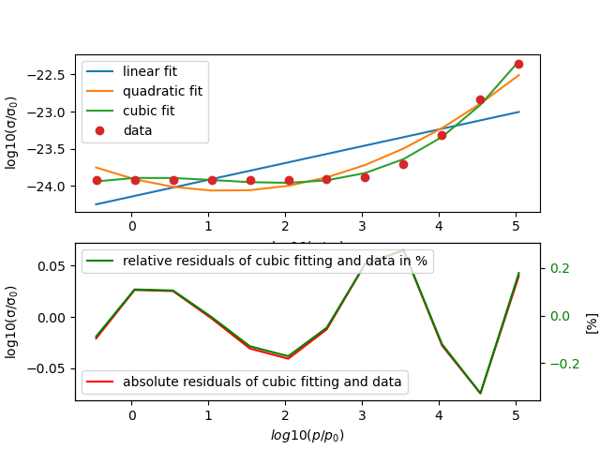
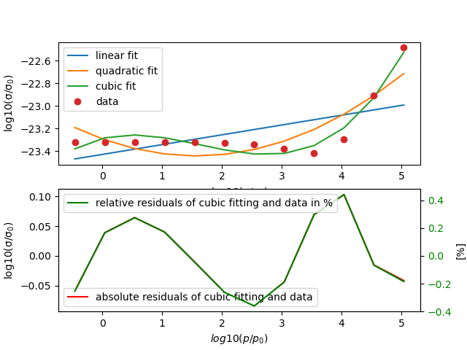
CO2 at main absorption peak (2340 cm⁻¹)
Temperature: 240 K (left) and 360 K (right)
linear and quadratic fit don”t match at all
Very good cubic fit for 240 K (res = 0.019 and rmse = 0.040)
Cubic fit in general good but also less precise than fits at other frequencies for 360 K (res = 0.041 and rmse = 0.058)
Notes:
Better absorption at higher temperatures

Slide 4
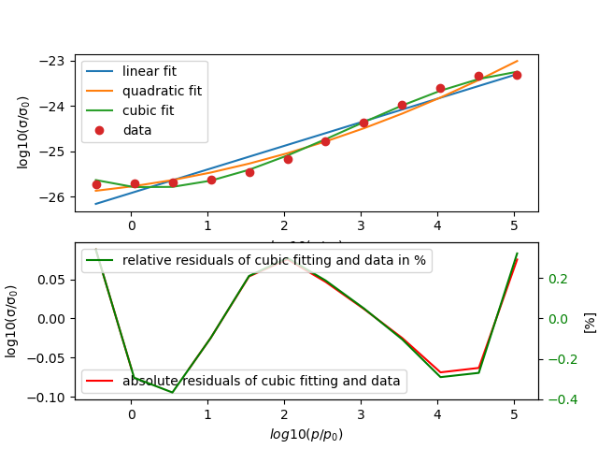
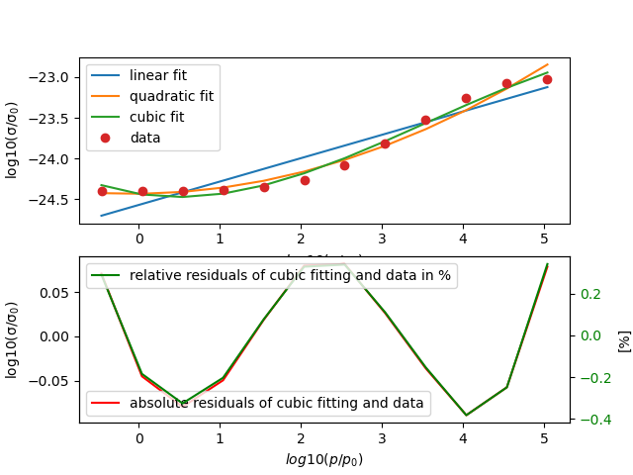
Ozone main absorption peak
frequency: 1003 cm⁻¹
Temperature: 240 K (left) and 360 K (right)
not well matching linear and quadratic fit
good cubic fits (for 240 K: res = 0.049, rmse = 0.064 )
(for 360 K: res = 0.048 and rmse = 0.064)
Notes:
Idea especially pressure broadening can be described by a polynomial fit, other effects worse describable (but probably wromg because absolute and relative residual are staying more or less the same

Slide 5
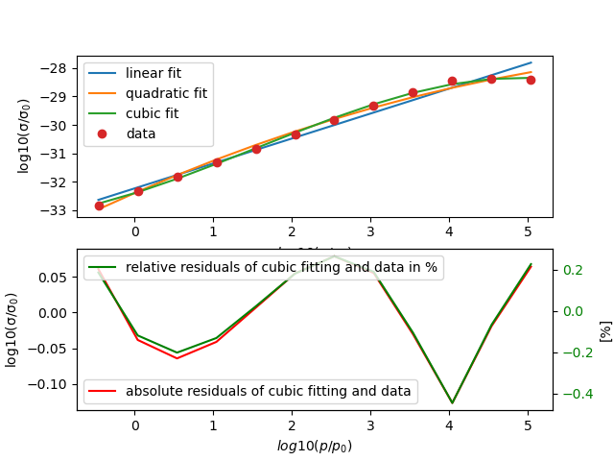
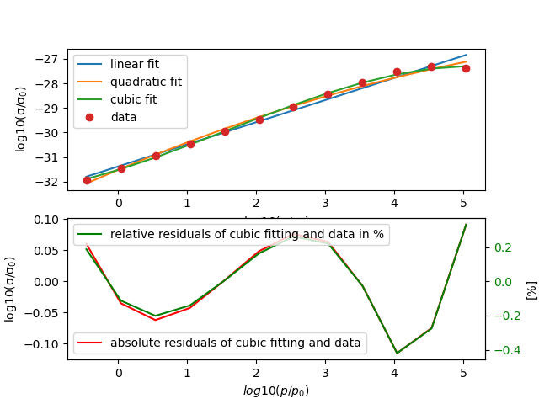
Ozone far away from absorption peak
Frequency: 295 cm⁻¹
Temperature: 240 K and 360 K
in general, good but not sufficient linear and quadratic fit
Flattening at higher pressure only fitted well by cubic fit
for 240K: res = 0.0448 and rmse = 0.236
for 360K: res = 0.05 and rmse = 0.204

Slide 6
Table with all so far done 1 dim fits
 | gas | v [cm⁻¹] | T [K] | linear fit good? (res) | quad. fit good? (res) | cubic fit good? (res) | absortion peak?
 | CO₂ | 102 (point6) | 240 | 4.8 * 10⁻⁶(excellent) | 2.7 * 10⁻⁶(excellent) | 1.2 * 10⁻⁶ (excellent) | no absorption peak
 | CO₂ | 102 (point6) | 360 | 5.7 * 10⁻⁵(excellent) | 3.26 * 10⁻⁵(excellent) | 1.48 * 10⁻⁵(excellent) | no absorption peak
 | CO₂ | 649 (point40) | 240 | 0.332 (quite good) | 0.111 (good) | 0.019 (very good) | main absorption peak
 | CO₂ | 649 (point40) | 360 | 0.457 (quite good) | 0.276 (good) | 0.031 (very god) | main absorption peak
 | CO₂ | 1003(point 62) | 240 | 1.35 * 10⁻⁵(excellent) | 7.51* 10⁻⁶ (excellent) | 3.29* 10⁻⁶ (excellent) | no absorption peak
 | CO₂ | 1003(point 62) | 360 | 0.0003 (very good) | 0.0001 (very good) | 6.2 * 10⁻⁵(excellent) | no absorption peak
 | CO₂ | 2340(point 145) | 240 | 1.166 (very bad) | 0.186 (good) | 0.019 (good) | main absorption peak
 | CO₂ | 2340 (point 145) | 360 | 0.517 (bad) | 0.21 (bad) | 0.041 (good) | main absorption peak
 | O₃ | 102 (point6) | 240 | 0.634 (not good) | 0.142 (good) | 0.015 (good) | no absorption peak
 | O₃ | 102 (point6) | 360 | 0.897 (not good) | 0.179 (good) | 0.0096 (excellent) | no absorption peak
 | O₃ | 295(point 18) | 240 | 0.675 (bad) | 0.236 (bad) | 0.0448 (quite good) | no absorption peak
 | O₃ | 295(point 18) | 360 | 0.507 (bad) | 0.204 (quite good) | 0.05 (quite good) | no absorption peak
 | O₃ | 1003(point 62) | 240 | 0.646 (bad) | 0.313 (quite good) | 0.049 (good especially high P) | main absorption peak
 | O₃ | 1003(point 62) | 360 | 0.398 (bad) | 0.094 (good) | 0.048 (good) | main absorption peak

Slide 7
Table with all so far done 1 dim fits
gas | v [cm⁻¹] | T [K] | linear fit good? (res) | quad. fit good? (res) | cubic fit good? (res) | cubic fit good rmse | maximal residual | minimal residual | absortion peak?
CO₂ | 102 (point6) | 240 | 4.8 * 10⁻⁶(excellent) | 2.7 * 10⁻⁶(excellent) | 1.2 * 10⁻⁶ (excellent) |  |  |  | no absorption peak
CO₂ | 102 (point6) | 360 | 5.7 * 10⁻⁵(excellent) | 3.26 * 10⁻⁵(excellent) | 1.48 * 10⁻⁵(excellent) |  |  |  | no absorption peak
CO₂ | 649 (point40) | 240 | 0.332 (quite good) | 0.111 (good) | 0.019 (very good) | 0.040 | 0.005 (0.021%) | (-0.082) (0.347%) | main absorption peak
CO₂ | 649 (point40) | 360 | 0.457 (quite good) | 0.276 (good) | 0.031 (very god) | 0.050 | (-0.003) | (-0.097) | main absorption peak
CO₂ | 1003(point 62) | 240 | 1.35 * 10⁻⁵(excellent) | 7.51* 10⁻⁶ (excellent) | 3.29* 10⁻⁶ (excellent) | 0.00052 | (-4.31 * 10⁻⁵ ) (-0.0013%) | (-0.00012) (-0.0039%) | no absorption peak
CO₂ | 1003(point 62) | 360 | 0.0003 (very good) | 0.0001 (very good) | 6.2 * 10⁻⁵(excellent) | 0.0023 | (-0.00017) (-0.00053%) | (-0.0050) (0.01736) | no absorption peak
CO₂ | 2340(point 145) | 240 | 1.166 (very bad) | 0.186 (good) | 0.019 (good) | 0.040 | (-0.0013) (-0.0056%) | (0.0746) (0.3296) | main absorption peak
CO₂ | 2340 (point 145) | 360 | 0.517 (bad) | 0.21 (bad) | 0.041 (good) | 0.058 | (-0.0101)(-0.0432%) | 0.01029 (0.4419%) | main absorption peak
O₃ | 102 (point6) | 240 | 0.634 (not good) | 0.142 (good) | 0.015 (good) |  |  |  | no absorption peak
O₃ | 102 (point6) | 360 | 0.897 (not good) | 0.179 (good) | 0.0096 (excellent) |  |  |  | no absorption peak
O₃ | 295(point 18) | 240 | 0.675 (bad) | 0.236 (bad) | 0.0448 (quite good) | 0.0611 | 0.00657 (0.0213%) | (-0.12676) (-0.4457%) | no absorption peak
O₃ | 295(point 18) | 360 | 0.507 (bad) | 0.204 (quite good) | 0.05 (quite good) | 0.0645 | 0.0012 (0.0042%) | (-0.11552) (-0.4198%) | no absorption peak
O₃ | 1003(point 62) | 240 | 0.646 (bad) | 0.313 (quite good) | 0.049 (good especially high P) | 0.064 | 0.0121 (0.0499%) | (-0.0943)(-0.3669%) | main absorption peak
O₃ | 1003(point 62) | 360 | 0.398 (bad) | 0.094 (good) | 0.048 (good) | 0.064 | 0.01858 (0.0763%) | (-0.0887) (-0.3815%) | main absorption peak

Slide 8
Main results and following estimations
In general, polynomial fitting of log10(cross section) with log10(p/p0) seems a well applicable approach.
Fitting order must be at least 3rd order
Fit seem to match better at higher presure (maybe only pressure broadening well described by polynomial function?)
Fits seem to match better often already linear at small absorption than at absorption peak
Notes:
Maybe: For CO2 fits seem to match better at low temperatures e.g. for 2340 cm⁻¹

Slide 9
Main results and following estimations
In general, polynomial fitting of log10(cross section) with log10(p/p0) seems a well applicable approach.
Fitting order must be at least 3rd order
Fit seem to match better at higher presure (maybe only pressure broadening well described by polynomial function?)
Fits seem to match better often already linear at small absorption than at absorption peak
Notes:
Maybe: For CO2 fits seem to match better at low temperatures e.g. for 2340 cm⁻¹

Slide 10
Further steps
Develop good standardisation for quality estimation of fit and average deviation
Make fit with higher order polynoms
Think about physical justification of the polynomial fitting in 1 dimensional
Take more or less sample points and evaluate fit quality
Notes:
Split up in training and data set

Slide 11
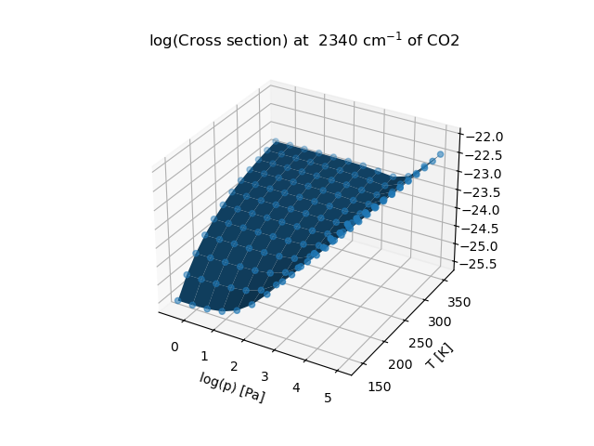
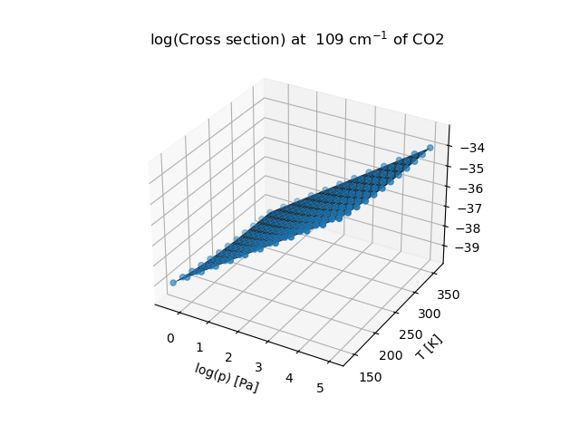
First 3 dimensional plots
plotted the log(p) and T dependance of the log(cross section)
Better optical visualization and estimation of smoothness or not smoothness than with the color plot
Notes:
Question save the plot with the rotating possibility later

Slide 12
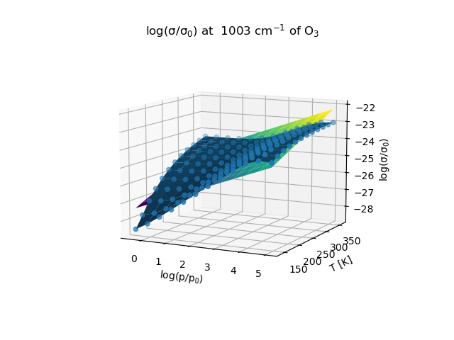
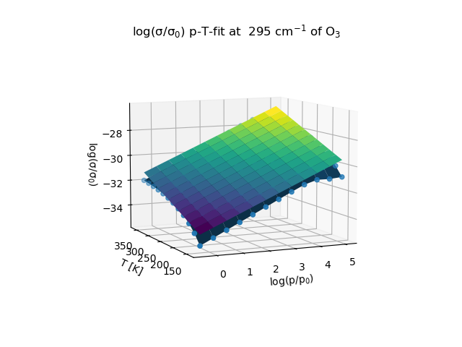
First 2 dimensional linear fits (ozone)
2 dimensional linear p-T fit of log(cross section) at one absorption peak (left) and far away from absorption peak (right)
Notes:
Seems to be more linear (far away from absorption peak) (explian physically missing)

Slide 13
Summary and to do now
Developed the basis for 1 and 2 dimensional fitting
Study now more strategically the fitting conditions/ also with R² values
Go to higher polynomials
Get good physical justification of the fits
Especially write a general polynomial parametrization with general quality indicator
Notes:
Further to do split in training and fitting set and see when overfitting starts

Slide 14
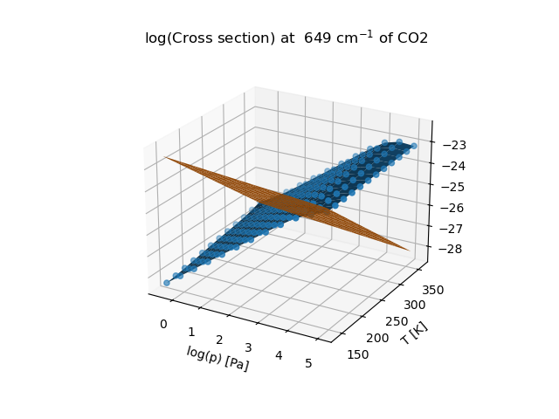
Try out linear fitting of 2 dim function
Notes:
Question save the plot with the rotating possibility later question:
What can be the mistake of my fit?

